Slide 1
SecurePass
Presented by:
Rana Ben Fraj
Rabie Karouia
Amal Ben Hafaith
Mohamed Amine Gaaloul

Slide 2
INTRODUCTION
In the realm of cybersecurity, the integrity of our digital identities and sensitive information hinges on the strength of our passwords. As digital systems continue to evolve, ensuring robust password security has become imperative.
Welcome to our presentation on creating a strong password checker, a tool designed to fortify the security of online accounts by evaluating the strength of passwords against various criteria. In this project, we will delve into the intricacies of password strength, explore the criteria that define a strong password, showcase existing password checker tools, discuss the benefits of implementing a strong password policy, highlight best practices for creating secure passwords, and conclude with actionable insights for bolstering cyber security.

Slide 3
Table of Contents
01
02
03
04
Executable Code
OVERVIEW
05
Code
Output
Overview Components Functional Flow
Main Existing Solutions
Advantages
Limitations
High Level Design
Inputs & Outputs Use Case Diagram Class Diagram
Development Phases
Tasks
Tools

Slide 4
01
OVERVIEW
Overview Components Functional Flow

Slide 5
Purpose
1
→ The purpose of this project is to delve into the intricacies of password strength and the role of password strength checkers in enhancing cybersecurity. By understanding the criteria for assessing password strength and leveraging advanced algorithms, we aim to equip users with the knowledge and tools needed to create and maintain secure passwords effectively.

Slide 6
Scope
2
→ The project aims to develop a password strength checker tool that evaluates passwords based on length, complexity, and uniqueness, providing users with insights and guiding them towards best practices for password security.

Slide 7
User Characteristics:
The password strength checker system caters to a broad range of users, including individuals, businesses, and organizations seeking to enhance their cybersecurity posture. It is designed for users who value security and aim to create and maintain strong passwords to protect their digital assets.
General Constraints:
Effective operation of the password strength checker system and secure database requires:
Reliable internet access and a modern web browser for users.
Backend infrastructure for securely storing and managing hashed and salted passwords.
Implementation of industry-standard encryption techniques to safeguard sensitive data.
Compliance with relevant data protection regulations and cybersecurity best practices.

Slide 8
Product Perspective
The core elements of our password strength checker system include:
Password Input: Users provide their passwords, which are then evaluated for strength.
Strength Evaluation: The system analyzes passwords based on criteria such as length, complexity, and uniqueness.
Secure Database: Hashed and salted passwords are securely stored in a database, safeguarding them against unauthorized access.
Result Display: Users receive feedback on the strength of their passwords, highlighting areas for improvement if necessary.
Optional Features: Advanced options may include password generation suggestions

Slide 9
Functional Flow:
User Input: Users input their passwords into the system through a designated interface or form.
Password Analysis: Upon receiving the password input, the system begins the analysis process. This involves evaluating the password based on multiple criteria, including:
Length: Assessing the number of characters in the password.
Complexity: Checking for a combination of uppercase letters, lowercase letters, numbers, and special symbols to gauge complexity.
Uniqueness: Verifying that the password does not match common passwords or predictable patterns.

Slide 10
Criteria Evaluation:
The system compares the password against predefined criteria thresholds to determine its strength level.
Database Storage: Once the password analysis is complete and the strength level is determined, the system securely stores the password in a database. This storage process includes:
Hashing: Converting the password into a unique hash value using cryptographic hashing algorithms such as SHA-256 or bcrypt.
Salting: Adding a random salt value to the hashed password before storage, further enhancing security by preventing rainbow table attacks.

Slide 11
Feedback Display:
After storing the password, the system provides feedback to the user regarding the strength of their password. This feedback includes:
Strength Level: Informing the user whether their password is weak, moderate, strong, or very strong based on the analysis results.
Improvement Suggestions: Offering suggestions for improving password strength, such as increasing length, adding complexity, or avoiding common patterns.
Optional Features Integration:
For systems with optional features such as password generation suggestions, the functional flow includes seamlessly integrating these suggestions into the feedback provided to the user. This integration aims to assist users in creating stronger passwords based on recommended criteria.

Slide 12
02
Main Existing Solutions

Slide 13
Traditional Methods: Assess based on character types and length.
Entropy Calculators: Calculate unpredictability and randomness.
Password Strength Meters: Provide real-time feedback on strength.
Online Tools and APIs: Instant strength checks and integration options.
Machine Learning-Based Solutions: Detect patterns and improve over time.
Password Managers: Include built-in strength assessment and best practices.
Security Standards: Provide guidelines for evaluation and best practices.

Slide 14
Advantages & Limitations
Advantages
Limitations
Security Boost: Generates strong passwords, enhancing user account security.
User-Friendly: Simple interface for easy password checking and creation.
Customization: Users can set specific strength criteria.
Instant Feedback: Provides real-time strength assessment.
Integration: Easily integrates into various platforms.
Criteria Dependency: Accuracy depends on chosen criteria.
Complexity: Customization options may be overwhelming.
Over-Reliance Risk: Users might solely rely on the checker without understanding broader security practices.
Resource Usage: May require significant computational resources.
Misinterpretation Risk: Strong password suggestions might be seen as overly complex.

Slide 15
03
Inputs & Outputs Use Case Diagram Class Diagram

Slide 16
Architecture
Frontend: User input interface and feedback display.
Backend: Password analysis, database interactions, and feedback generation.
Database: Secure storage of hashed and salted passwords.

Slide 17
Data Flow
Analysis
Feedback Generation
User Input
Day 1
Day 2
Day 3
Day 4
Database Storage
User Interface.

Slide 18
Security Scalability & Performance
Security:
Hashing, salting for password security.
Encryption for data transmission/storage.
Access control for system protection.
Scalability & Performance:
Scalable architecture for increased load.
Performance optimization through caching, efficient algorithms.

Slide 19
04
Tools and Development Phases

Slide 20
Tools Used
Programming Language: Python (Back-end)
Web Framework: Flask
Database: SQLAlchemy
Front-end Framework: HTML CSS

Slide 21
Development Tasks
Task 1: Set up development environment and tools.
Task 2: Design and implement front-end.
Task 3: Implement back-end functionality.
Task 4: Integrate components and test basic functionality.
Task 5: Add features and refine user interface.
Task 6: Implement API endpoints and document.
Task 7: Perform comprehensive testing.
Task 8: Deploy to web server or cloud platform, and conduct final testing.

Slide 22
05
Executable Code

Slide 23
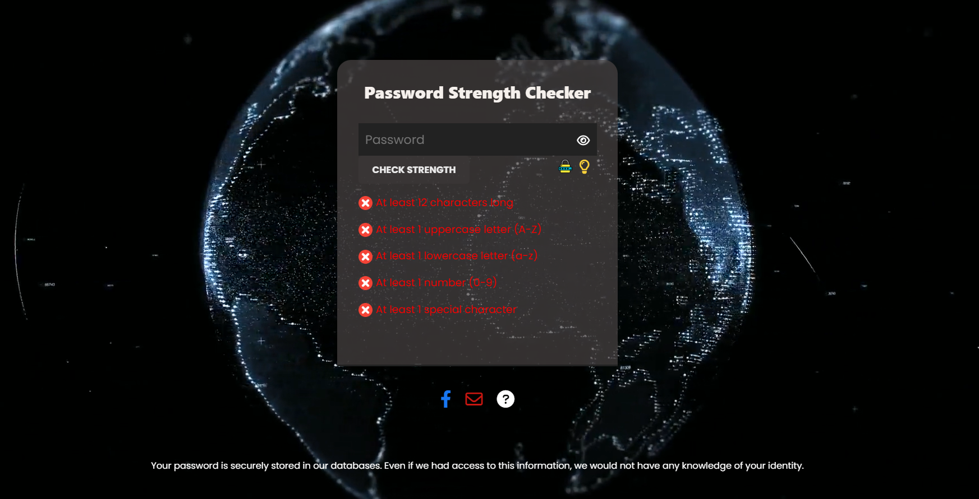
Output: USER-INTERFACE

Slide 24
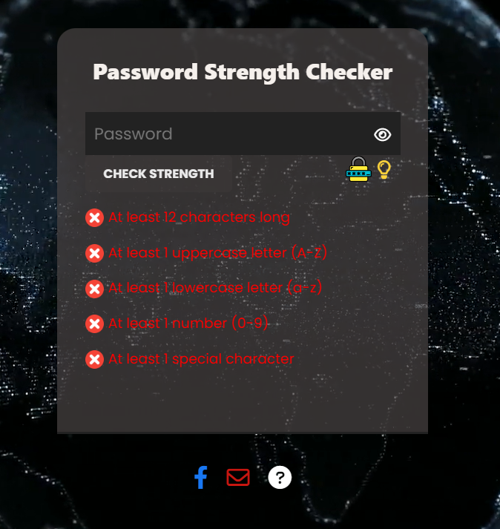
Submit Button: Ensure secure data submission and provide clear feedback on password strength.
Tips Article: Keep tips accurate, concise, and relevant to users' needs.
Contact Information: Provide valid and monitored contact details for prompt support.
"Lock" Button: Generate strong passwords securely, allowing user customization.
1
4
2
3

Slide 25
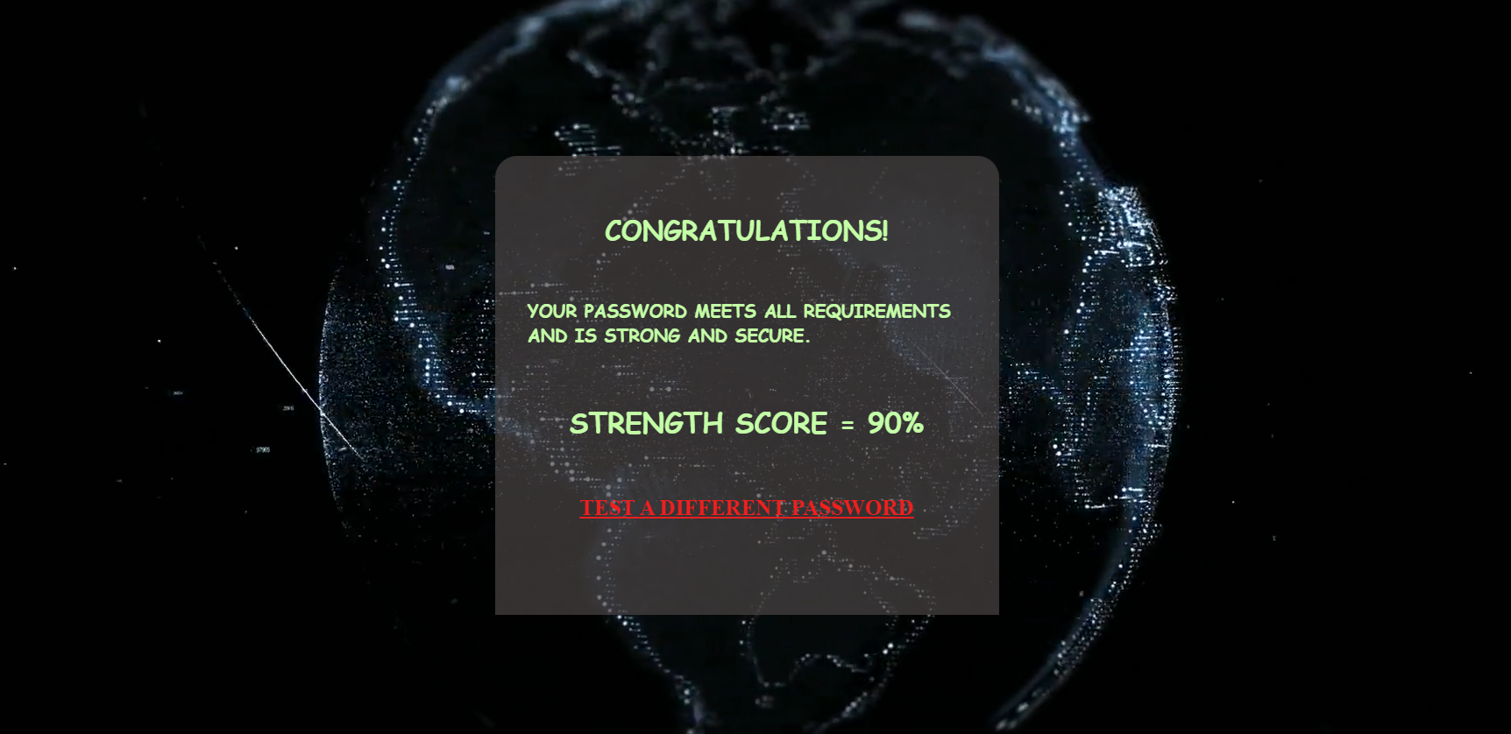

Slide 26
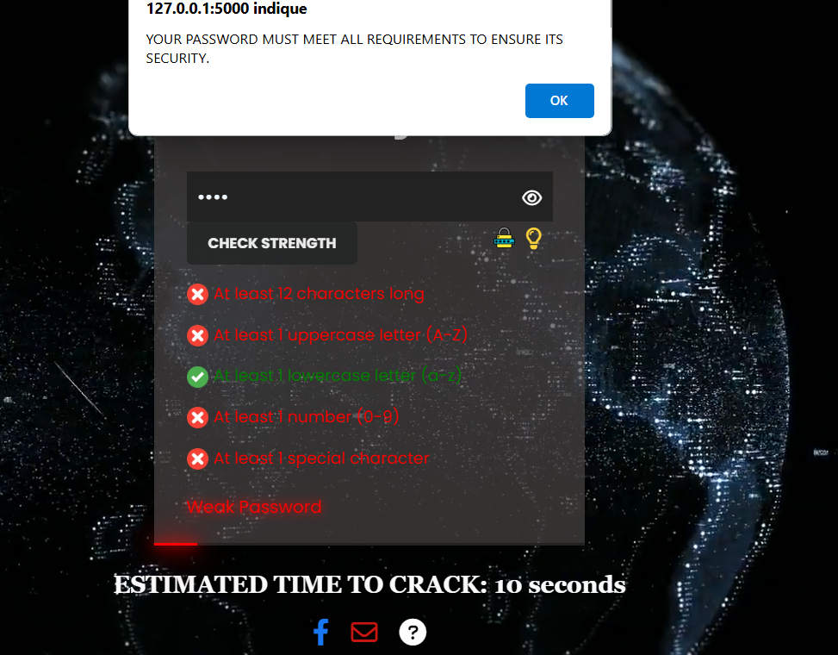

Slide 27
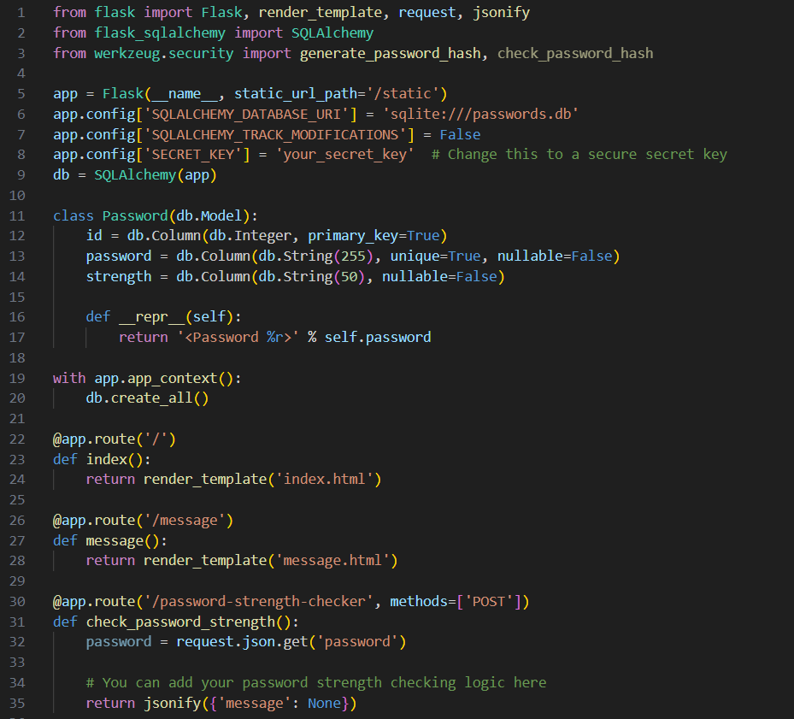
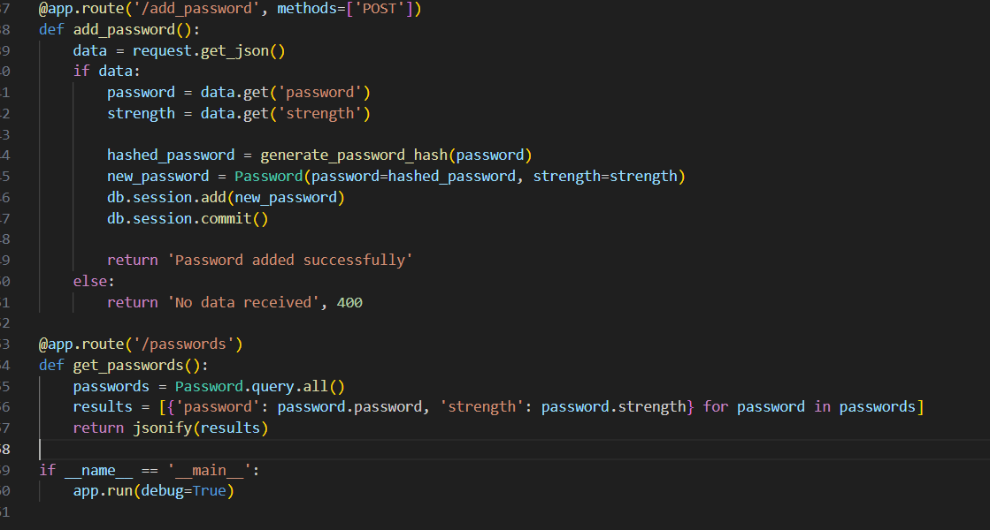
Back-end Development (Python with Flask and SQLAlchemy)

Slide 28
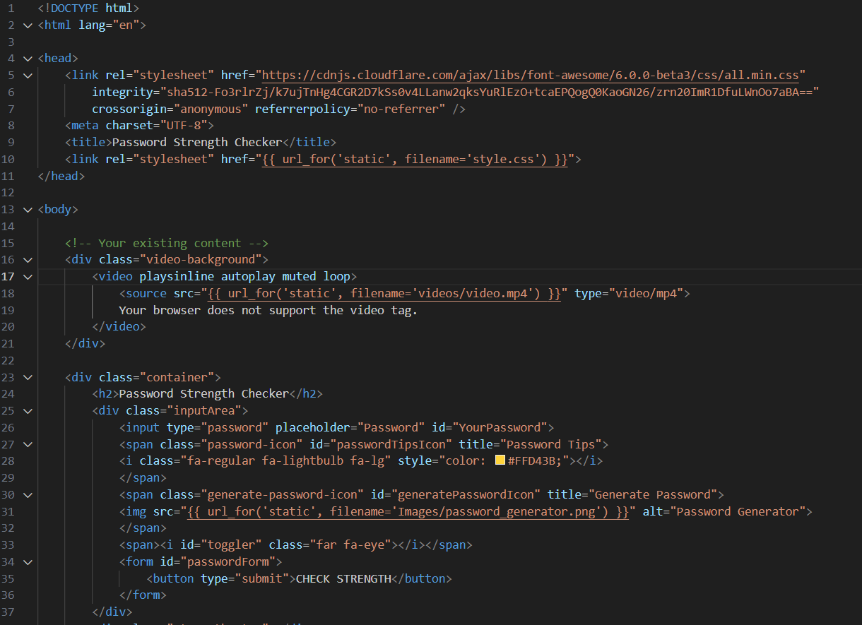
index.html
Front-end Development (HTML/CSS/JavaScript with Flask)

Slide 29
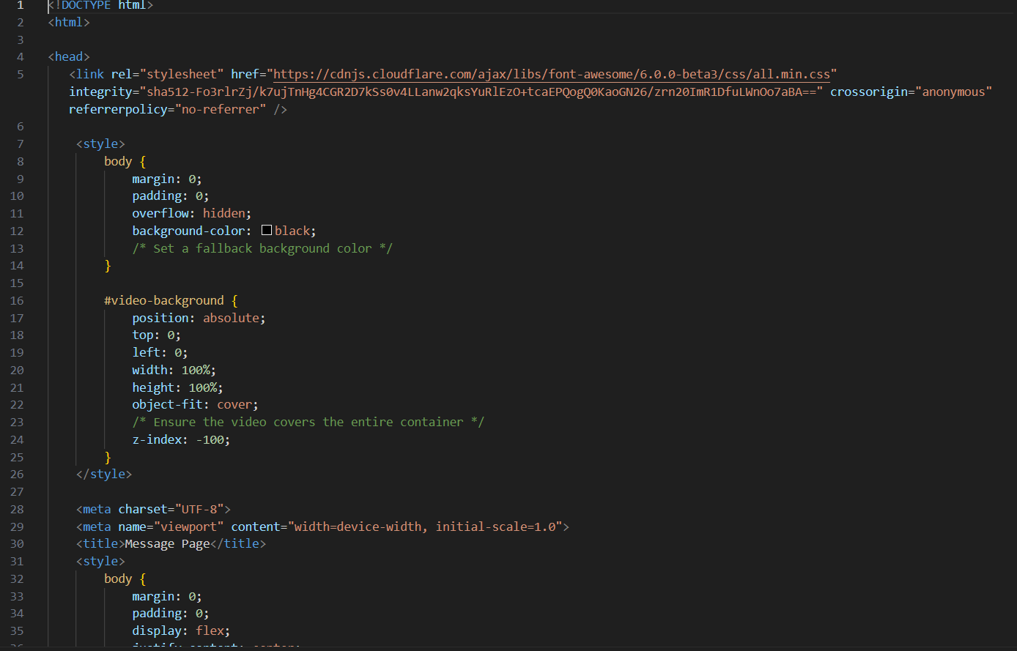
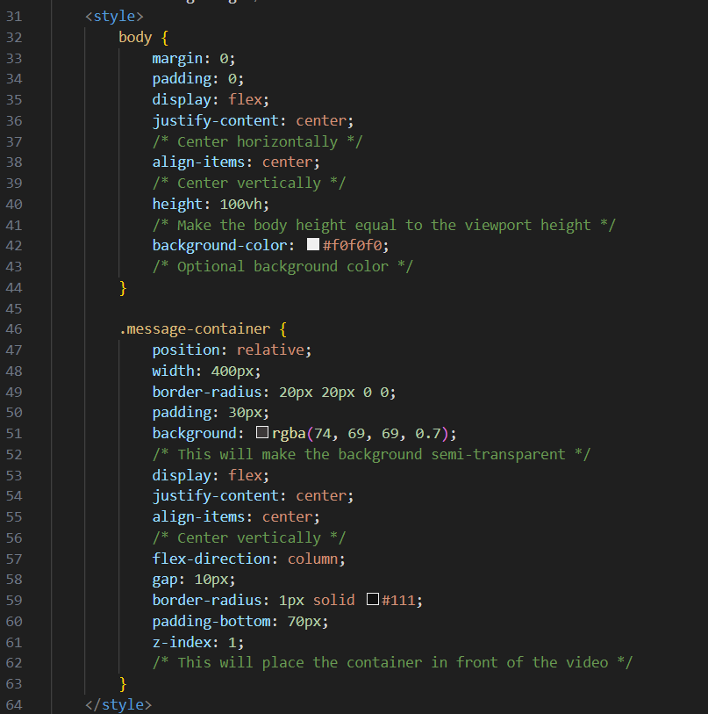
Message.html

Slide 30
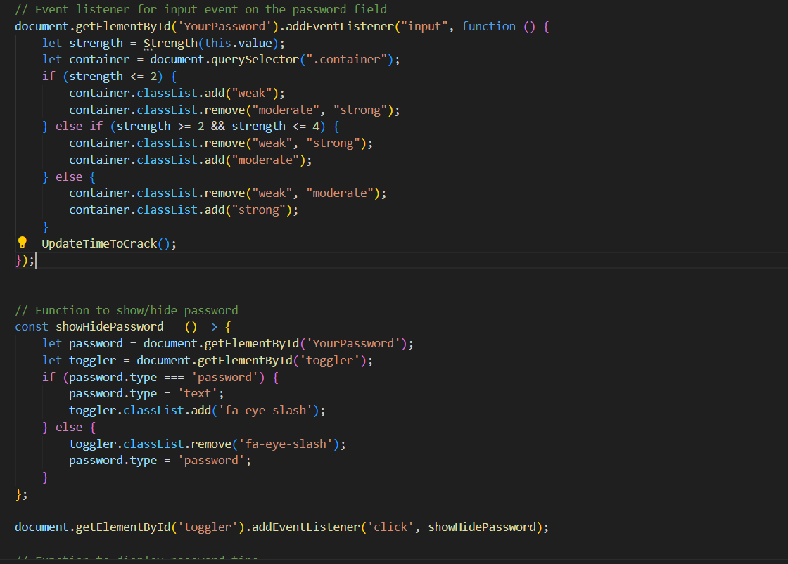
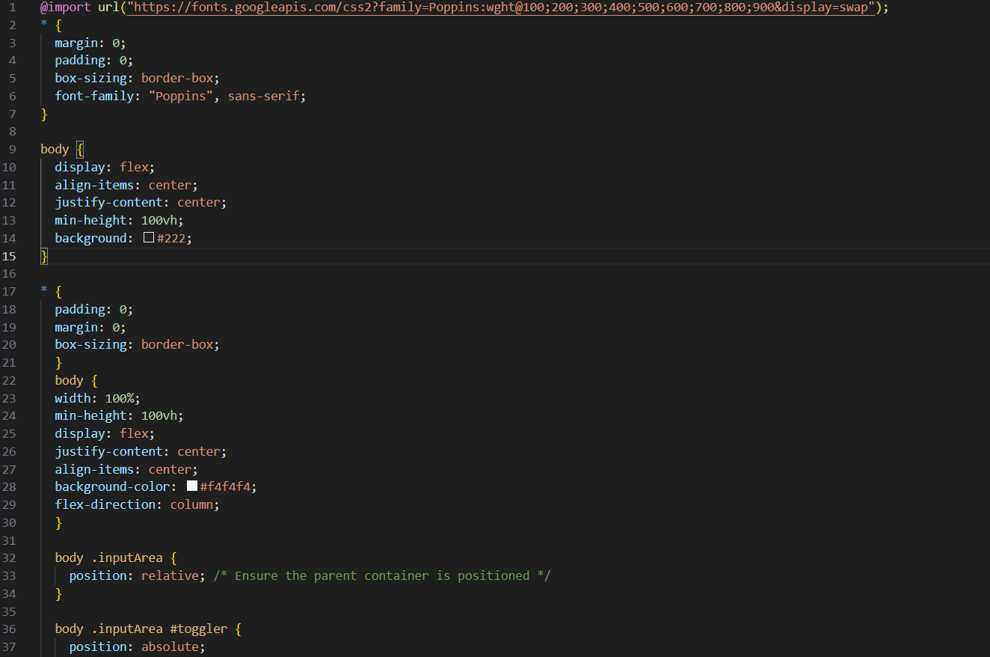
script.js
Style.css

Slide 31
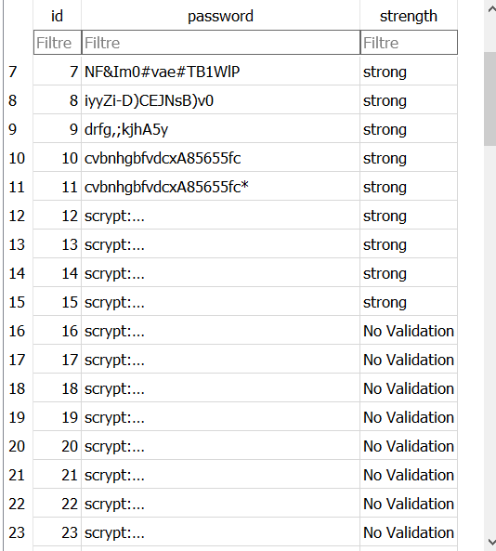
Storing Passwd with SQLAlchemy)

Slide 32
Github link
https://www.google.com/url?q=https://github.com/rabie-karouia/Password-Strength-Checker/tree/main/security%2520final%2520project_passwd&sa=D&source=editors&ust=1717117801942222&usg=AOvVaw1VoeUy05xFuClShGcesfS_

Slide 33
Thank You!

